Slide 1
BRITISH AIRWAYS
Web scraping to gain company insights
Sridhar Yadav Kaluri
28-06-2024

Slide 2
*Importing Necessary Libraries*
import requests
import pandas as pd
import os
import string
import nltk
import matplotlib.pyplot as plt
from bs4 import BeautifulSoup

Slide 3
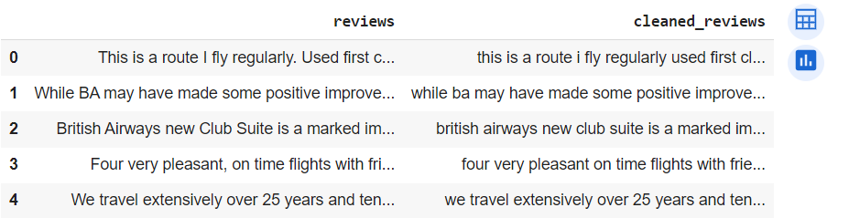
*Reading the Airline Reviews*
Here we are reading the data from airlinequality i.e,
base_url = https://www.airlinequality.com/airline-reviews/british-airways
We are checking with the 1000 reviews, given by the customers.
We have saved our data in a CSV file as: df.to_csv(“data/British_reviews.csv”)
From the data, we have converted upper case letters to lower case and also removed punctuations.

Slide 4
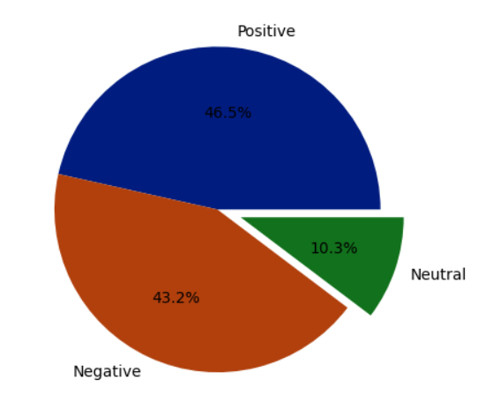
*Data Visualization : Pie Chart*
By cleaning 1000 reviews, we got the positive reviews, negative reviews and neutral reviews.
Positive Reviews : 46.5%
Negative Reviews : 43.25
Neutral Reviews : 10.3%

Slide 5
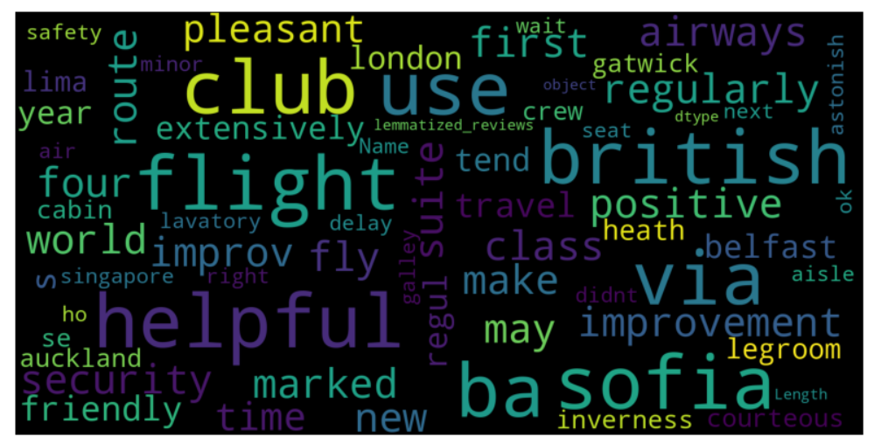
*Data Visualization : Word Cloud*

Slide 6
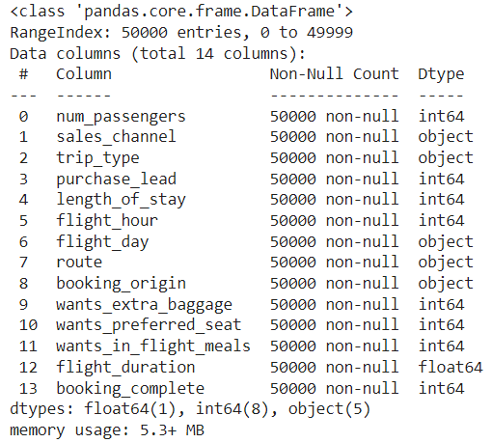
*Exploratory Data Analysis*
We have imported the customer bookings data set:
cust = pd.read_csv("customer_booking.csv", encoding='latin-1') # Try reading with 'latin-1' encoding
The total dataset is of (50000, 14) shape.
Checking the columns datatypes.

Slide 7
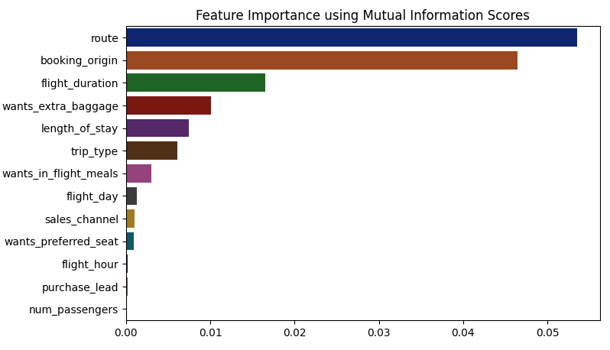
*Feature Importance*

Slide 8
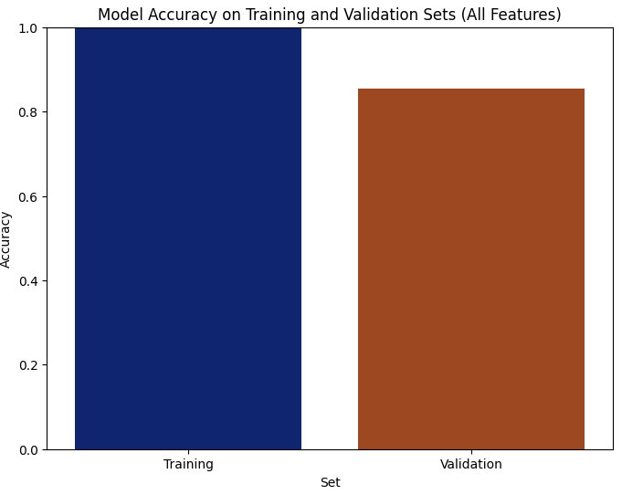
*Model Training & Conclusion*
We have trained the dataset with RandomForest Classifier.
We got the,
Training Accuracy Score : 99.98
Validation Accuracy Score : 85.39

